Slide 1

Module 2
Regression Basics
Notes:
Guidelines
Use section headers to chunk content in your presentation.
Use the same style of section header throughout your presentation.
Keep your title to no more than 2 lines.

Slide 2

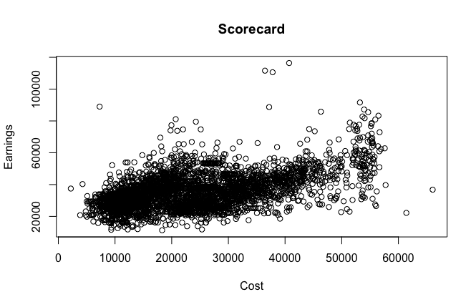
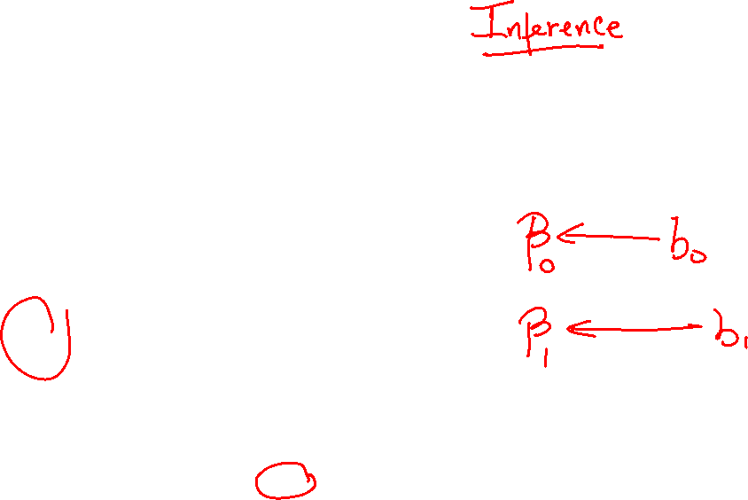
Example
y = md_earn_wne_p10
x = Cost4_A

Slide 3

Practice

Slide 4
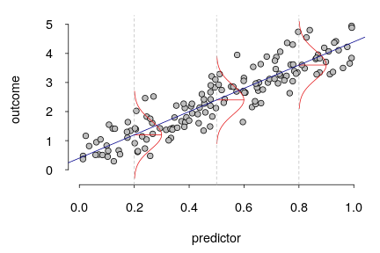
Assumptions, MSE, RMSE
Notes:
Guidelines
Use a title slide at the beginning of your presentation. There are 9 variations of title slides to choose from.
If you will have a series of slideshows, we recommend using the same style of title slide for each presentation.
Keep your title to no more than 2 lines.
Do not change the font style or font size of the title or subtitle.

Slide 5

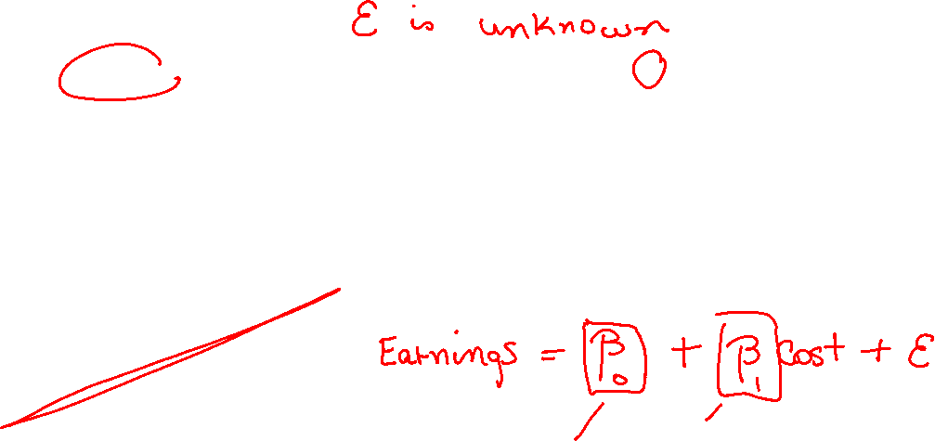
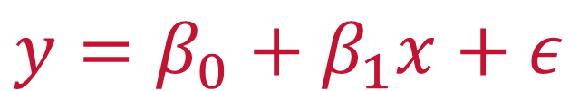
Linear Regression Assumptions
The mean of the probability distribution of $ε$ is 0.
The variance, $σ^{2}$ of the probability distribution of $ε$ is constant
The probability distribution of $ε$ is normal.
The errors associated are independent.
$$y=β_{0}+β_{1}x+ε$$

Slide 6
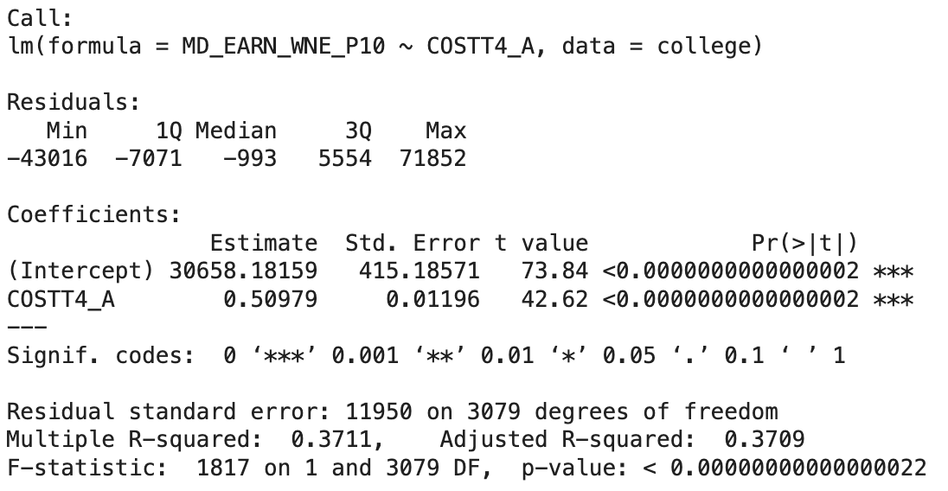

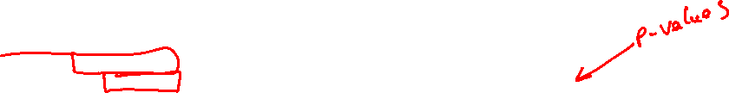
(Least-Squares) Estimates
Assumptions need to hold for p-values to make sense

Slide 7
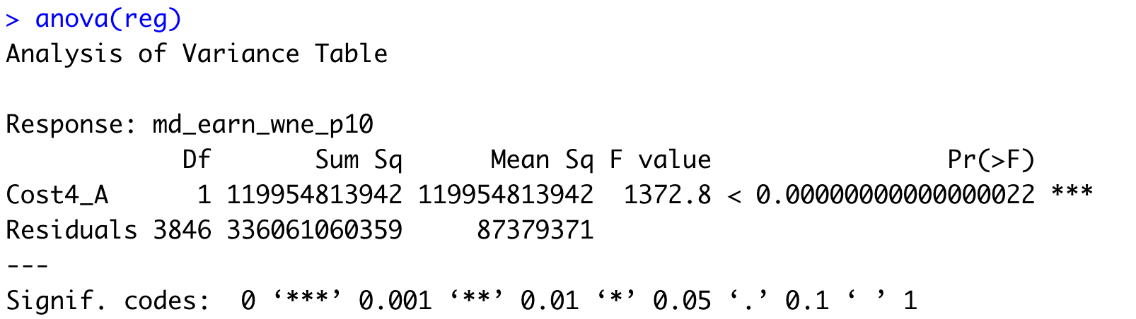

Sum of Squared Errors
Inference on the $F$ statistic depends on the assumptions being valid
Sum of Squared Errors (SSE)

Slide 8
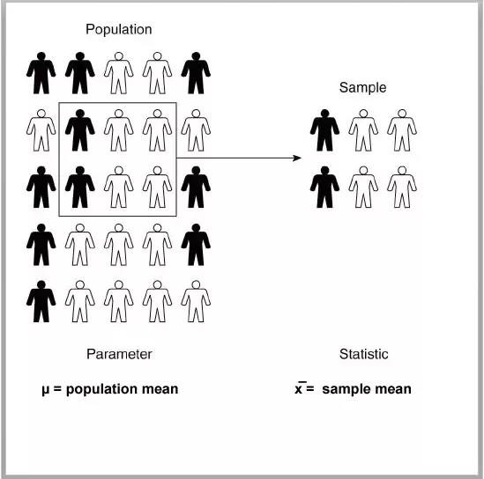
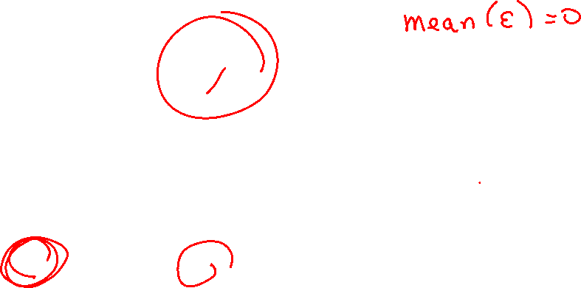



Assumption 1: MEAN OF $ε IS ZERO$
This means that the model is NOT biased
$$ε$$
$$e$$

Slide 9
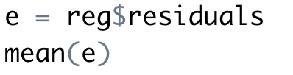
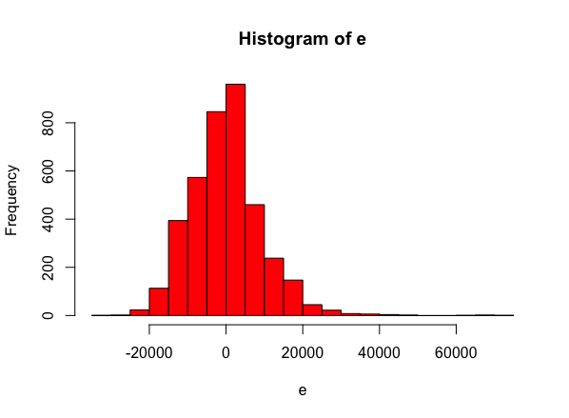
Assumption 1: MEAN OF $ε IS ZERO$
This means that the model is NOT biased

Slide 10
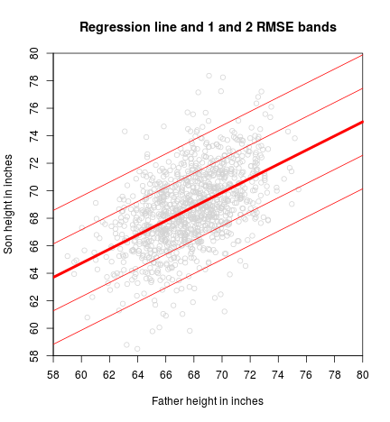

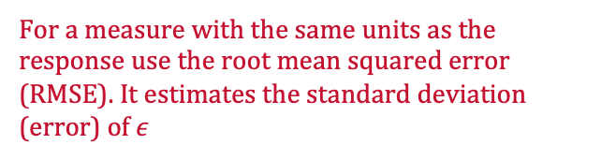




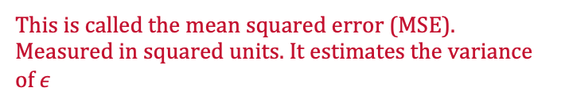
Assumption 2: VARIANCE OF $ε$ IS CONSTANT
What is the variance of $ε?$
$$MSE= s^{2}=\frac{SSE}{n−2}$$
RMSE = $s=\sqrt{s^{2}}$
This is called the mean squared error (MSE). Measured in squared units. It estimates the variance of $ε$
For a measure with the same units as the response use the root mean squared error (RMSE). It estimates the standard deviation (error) of $ε$

Slide 11
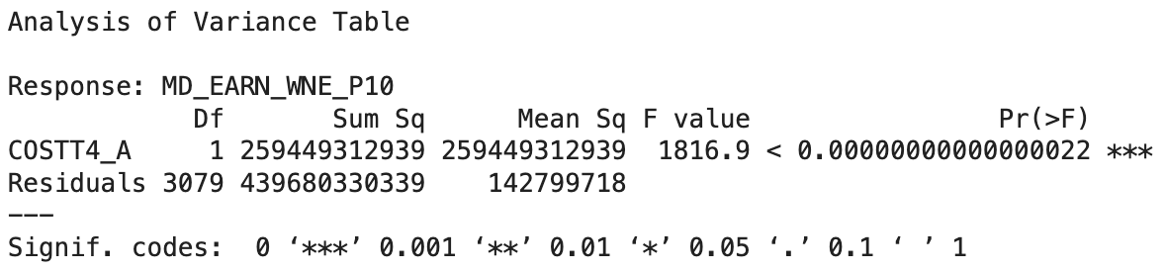


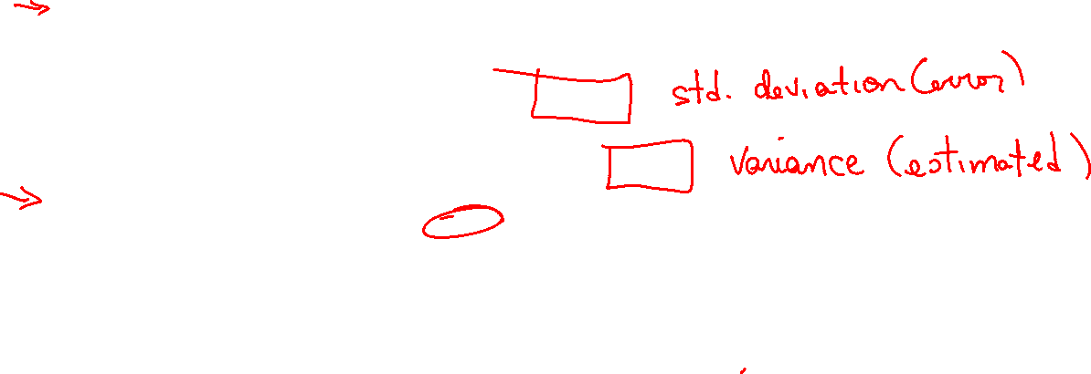
Assumption 2: VARIANCE OF $ε$ IS CONSTANT
RMSE and MSE are part of the regression output
$$RMSE$$
$$MSE$$

Slide 12
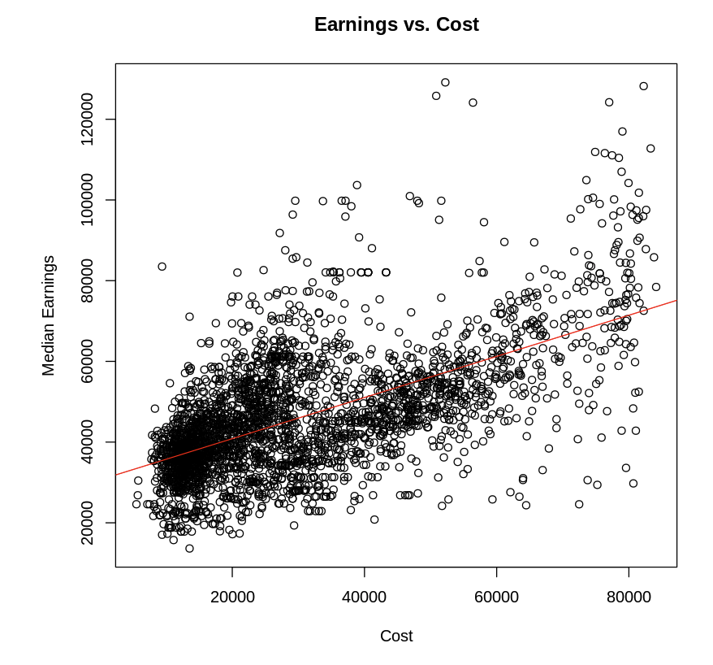
Assumption 2: VARIANCE OF $ε$ IS CONSTANT
You can check the scatter plots for constant variance

Slide 13
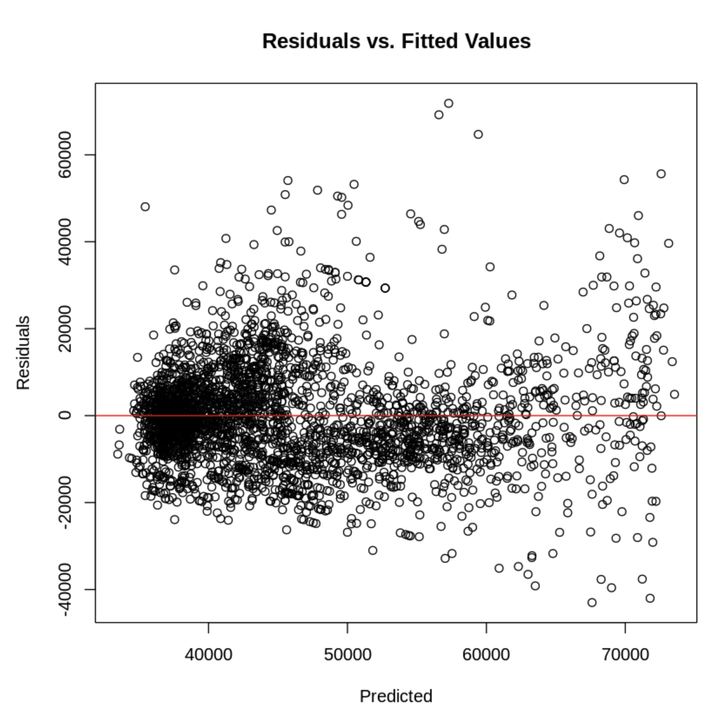

Assumption 2: VARIANCE OF $ε$ IS CONSTANT
For MLR, the residuals vs predicted is better using plot(reg)

Slide 14
Practice

Slide 15

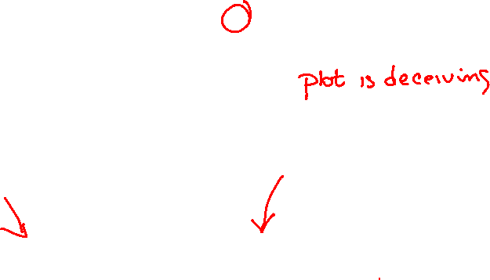
Assumption 3: $ε$ IS NORMALLY DISTRIBUTED
You can check the residuals using histograms

Slide 16
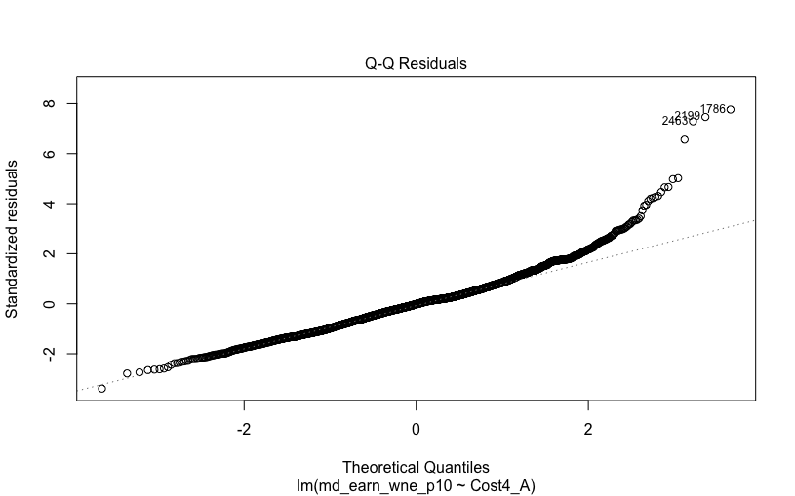
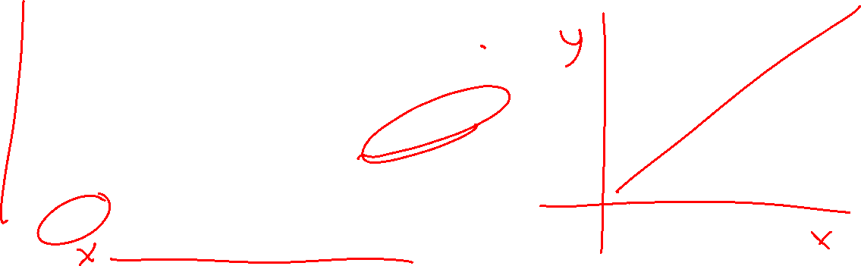
Assumption 3: $ε$ IS NORMALLY DISTRIBUTED
A Q-Q Plot is an easier plot to visualize

Slide 17
Practice

Slide 18
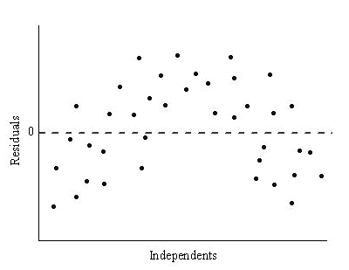

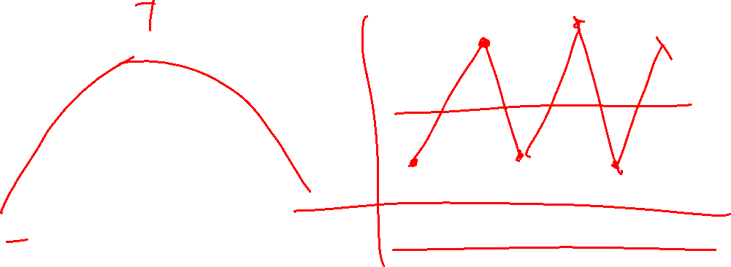
Assumption 4: $ε_{i}$ ARE INDEPENDENT
We are able to test this if we have a time/order variable
Time/Order Variable

